Slide 1
AI Updates
May 23, 2025
xxx
Computex 2025 - in Taiwan
Google I/O 2025
Microsoft Build 2025
Nvidia EoRA - improve compressed models
ARI = Advanced Research & Insights
Gemini Simplifies Text
BLIP3-o models generate CLIP image features
OpenAlpha_Evolve
Workday Launches 7 New AI Agents
OpenaAI Codex
WorldPM-72B family of models - open source
AGT AI Holograms
Metaphysic - metaphysic.ai
Cautious Prompt Phrasing Yields Better Results
AI’s Struggle to Read Analogue Clocks
Elon Musk - One Hour Rule
FastMCP - open source MCP Framework
Microsoft Magentic-UI web AI app
OpenAI buys "io" for $6.4 Bln
Amazon Vulcan Robot
Crowd-sourced "Arena" Leaderboard
Jobs, Layoffs

Slide 2
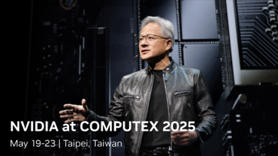
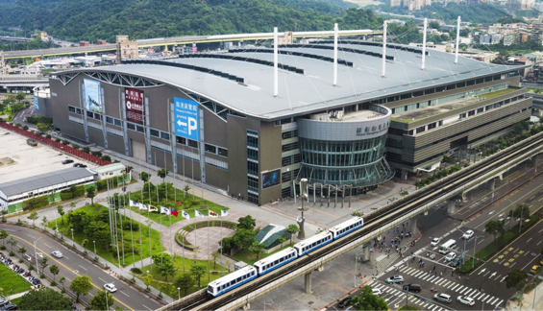
Computex 2025
Computex 2025 Mon-Fri May 19-23
one of the world’s largest technology trade shows, focusing primarily on computing, laptops, PC hardware, and the latest tech innovations.
This year theme - "AI Next" - AI & Robotics, Next-Gen Tech, and Future Mobility
Venue: Taipei Nangang Exhibition Center in Taipei, Taiwan

Slide 3
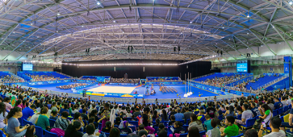
Computex 2025 - continued
Theme "AI Next", 1,400 exhibitors from 34 countries
May 19 Monday - dominated by AI, major announcements and keynotes from Nvidia, Qualcomm, and others.
Nvidia’s CEO Jensen Huang keynote - AI's transformative power. Grace Blackwell NVL72 System (one giant GPU). Each rack delivers compute power equivalent to hundreds of traditional datacenters
NVLink Fusion - mixed-vendor hardware integration at the rack scale
Robotics - hardware and software, omniverse training https://www.youtube.com/watch?v=bYF76aV0XUw
Foxconn Partnership to build a massive AI supercomputer in Taiwan, featuring 10,000 Blackwell GPUs
Software and Ecosystem
Qualcomm’s CEO Cristiano Amon keynote - Arm-based Snapdragon X on-device AI capabilities, Hexagon NPUs
Nearly every major company at Computex highlighted AI integration, from edge computing to robotics and industrial automation
Samsung announced its 2025 OLED TVs will support Nvidia G-Sync and AMD FreeSync Premium Pro, plus an AI-powered Auto Game Mode
MSI and Acer introduced 500 Hz QD-OLED monitors, leveraging AI for new features like presence detection to save power and extend panel life
InnoVEX platform 450 startups and a strong emphasis on AI-driven entrepreneurship and cross-border collaboration
According to Gartner, global spending on generative AI is projected to reach $644 billion in 2025; AI expected to become a standard feature in consumer electronics

Slide 4

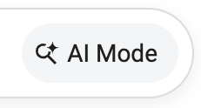
Google I/O 2025
Google I/O 2025 takes place May 20-21
Gemini 2.5 Pro + Deep Think – Now with thinking budgets and thought summaries, it tops the 2025 USAMO math benchmark and scores 84% on MMMU.
Veo 3 – Ultra-realistic generative video, now with smarter edits and prompt precision.
Jules Coder beta - Gemini crushes LiveCodeBench.
Gemini 2.5 Flash - Fast, lightweight, perfect for real-time apps.
Gemma 3n (5B & 8B) - edge on-device https://huggingface.co/google/gemma-3n-E4B-it-litert-preview
Updates to Gemini API, notebook-style prompting, ...
https://www.youtube.com/watch?v=Yzj7SW6sslA - video
Ironwood TPU: 7th gen, 10x performance - 42.5 exaflops per unit
Google Beam - AI-first video communications using 3D light field displays with near-perfect head tracking
Real-time speech translation in Google Meet (English and Spanish)
Android XR glasses
Google AI Pro and Google AI Ultra (higher limits , early features)
Flow - new AI filmmaking tool
Gemini 2.5 Pro Deep Think
Gemini Diffusion (for text) - 5x faster than before
Gemini in Chrome - understands page context as you browse
Gemini Robotics - model to teach robots
Veo 3 - new SOTA video/audio model
Lyria 2 - music generation with vocals, solos, and choirs
Improved text-to-speech, multi-voice, expressions, 24 languages
Imagen 4 - image generation, richer colors, details, 10x faster
Project Astra - universal AI assistant
Open Agent2Agent protocol (60+ partners)
Gemini SDK now compatible with MCP (Model Context Protocol)
Gemini in Google apps
Scientific models: AlphaProof (mathematics), Co-scientist (research collaboration), AlphaEvolve (algorithm discovery)
AMIE (medical diagnostics), AlphaFold 3 (molecular structure)
FireSat - detect wildfires as small as 270 ft using satellites and AI
Gemini has 400+ Mln monthly active users, gaining on ChatGPT's estimated 600 Mln

Slide 5
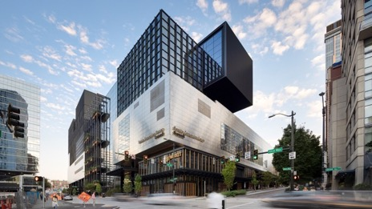
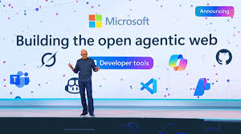

Microsoft Build 2025
Microsoft Build 2025 takes place from May 19-22, 2025, with the opening keynote starting on May 19th at 9AM PT / 12PM ET. The conference will be held both in person at the Seattle Convention Center and online via livestream.
AI - "open agentic web", Building AI-driven solutions
Azure AI Foundry - new pre-built AI agents, custom agent building blocks, and multi-agent capabilities - in a unified SDK; built-in metrics for performance, quality, cost, and safety; rtacing
Enterprise-Ready AI Governance
Microsoft 365 Copilot Innovations, fine-tuning models
The Copilot Wave 2 spring release, Copilot Notebooks, and new reasoning agents ("Researcher" and "Analyst")
Natural Language Web (NLWeb), a project led by R.V. Guha, which aims to transform websites into agentic apps with natural language interfaces https://news.microsoft.com/source/features/company-news/introducing-nlweb-bringing-conversational-interfaces-directly-to-the-web/
Microsoft Discovery - accelerate research and development (R&D) https://azure.microsoft.com/en-us/blog/transforming-rd-with-agentic-ai-introducing-microsoft-discovery/
GitHub Copilot chat is open-sourced under MIT license: (only VSCode chat extension was open-sourced. The cloud part was not open-sourced) https://github.com/features/copilot https://www.youtube.com/watch?v=NIgrGqmoeHs - video https://github.com/copilot-extensions/github-models-extension

Slide 6

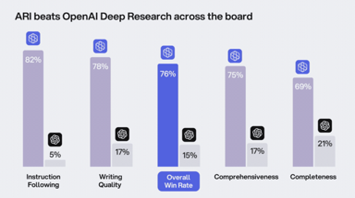
AI Updates - 1
Nvidia EoRA - improve compressed models
EoRA = Eigenspace Low-Rank Approximation
EoRA is designed to be used as a helper technique when compressing models, for example quantization to 4 bits
https://arxiv.org/abs/2410.21271 - paper
https://towardsdatascience.com/boost-2-bit-llm-accuracy-with-eora/
In practice, one can apply EoRA as compensation after quantization or pruning
ARI = Advanced Research & Insights
Professional-grade AI research agent developed by you.com
Processes 400+ Sources Simultaneously, uses Chain-of-Thought Reasoning, Real-Time Verification, Interactive Visualizations (charts, graphs), connect to internal data sources (SharePoint, Google Drive, OneDrive), supports collaboration - review, edit, and refine research plans and objectives
ARI outperforms OpenAI on multiple benchmarks
ARI saves time and reduces costs. Tasks that once took days or weeks (such as due diligence, market analysis, or clinical research) can now be completed in minutes

Slide 7
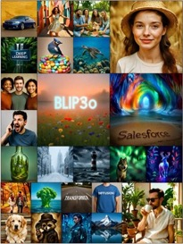
AI Updates - 2
Gemini Simplifies Text
AI makes complex text easier to understand, while keeping the original meaning
https://arxiv.org/abs/2505.01980 - paper
https://research.google/blog/making-complex-text-understandable-minimally-lossy-text-simplification-with-gemini/
BLIP3-o models generate CLIP image features
yields higher training efficiency and improved generative quality
uses diffusion transformer
open-sourced by Salesforce
https://huggingface.co/papers/2505.09568
OpenAlpha_Evolve
Open-Source analog of DeepMind's AlphaEvolve
Designed for researchers and developers.
https://github.com/shyamsaktawat/OpenAlpha_Evolve
Workday Launches 7 New AI Agents to Automate HR, Finance, and Legal Tasks; Workday is a cloud-based enterprise service used by over 60% of the Fortune 500
New AI Tools: Contract Intelligence Agent, Supplier Contracts Agent, and Contract Negotiation Agent automate contract review and editing; Document Driven Accounting Agent (invoices); Frontline Agent and Contingent Sourcing Agent (manage absences and temp hiring); Self-Service Agent: Answers employee questions and take action on their behalf

Slide 8
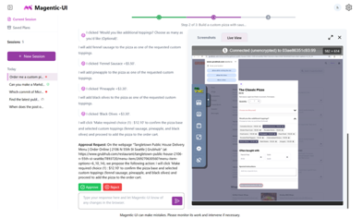

AI Updates - 3
# fastmcp run server.py
from fastmcp import FastMCP
mcp = FastMCP("Demo 🚀")
@mcp.tool()
def add(a: int, b: int) -> int:
"""Add two numbers"""
return a + b
if __name__ == "__main__":
mcp.run()
FastMCP - open source MCP Framework
https://github.com/jlowin/fastmcp
https://gofastmcp.com/getting-started/
Microsoft Magentic-UI web AI app
User can interact with a multi-agent system that can browse and perform actions on the live web, generate and execute code, and generate and analyze files
Agents: Orchestrator, WebSurfer, Coder, FileSurfer, UserProxy
Open-source (MIT license)
Human-centered, collaborative, transparent
https://github.com/microsoft/magentic-ui
OpenAI buys "io" for $6.4 Bln
"io" is a startup founded by Jony Ive in 2024. Jony Ive is the legendary designer behind Apple’s iPhone and MacBook
Jony Ive will take on creative and design responsibilities across both OpenAI and io, while his design firm LoveFrom will remain independent
The goal is to create physical products that "inspire, empower, and enable" users - https://openai.com/sam-and-jony/

Slide 9
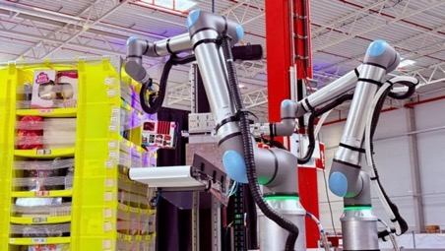
Amazon Vulcan Robot
Amazon Vulcan - a robot with a sense of touch
It works through AI
Can recognize objects by contact, capable of picking up, moving, and storing products while processing a large percentage of the inventory during real-world tests
It is the first robot capable of “feeling” what it does and knows what strength and speed to apply to avoid damaging the item
The robot’s other arm has a suction cup that can grab anything it wants to take from the compartments, with a camera and AI to make sure it only picks one item and not several by mistake
Vulcan learns from its mistakes and understands how objects behave when touched. When an object falls, gets stuck, or is not recognized, the system logs that error, so it doesn’t happen again.
Vulcan is operating in the logistics centres of Spokane (U.S.) and Hamburg (Germany). It has already processed more than half a million orders.
Vulcan can handle approximately 75% of available inventory. For now, it’s only being used to pick items located at the top of 2.4-meter stacks and those on the bottom, preventing workers from bending too much or having to climb ladders
https://unionrayo.com/en/amazon-vulcan-robot-sense-touch/

Slide 10
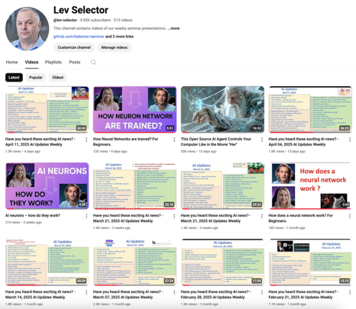
About this Channel:
We post our AI Updates
Every Friday after 3pm EST
It is usually 25-30 min long
Links to slides are under the videos
Subscribe to our YouTube channel to get notified when new videos are posted
https://www.youtube.com/@lev-selector

Slide 11
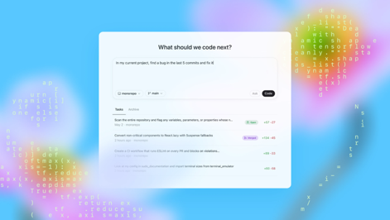
OpenaAI Codex
OpenAI Codex (May 2025)
latest AI-powered software engineering agent - collaborative, cloud-based
Can simultaneously manage multiple tasks which are assigned using text prompts: writing new features, fixing bugs, answering questions about codebases, running tests, and proposing pull requests
Each task operates in its own secure sandbox loaded with the user's code repository
Codex integrates with GitHub and can be accessed through the ChatGPT web interface
Human-Like Code Generation (new codex-1 model - a specialized version of OpenAI’s o3)
Codex iteratively tests its outputs until they pass, aiming for production-ready results
AGENTS.md - file created by human and placed in repo - provides project-specific guidelines, coding standards, and context
Codex operates in an isolated, internet-disabled environment, limiting its access to only the code and dependencies provided. It is designed to refuse requests for malicious software development and includes enhanced safety evaluations and policy frameworks to prevent abuse
Users can verify Codex’s work through citations, terminal logs, and test results. The agent explicitly communicates uncertainties or test failures
Codex is initially available to ChatGPT Pro, Team, and Enterprise users, with support for Plus and Edu users coming soon.
OpenAI has also updated Codex CLI, a lightweight open-source agent for terminal workflows. A smaller, faster codex-1 variant (codex-mini-latest) is now available, optimized for low-latency code Q&A and editing
https://openai.com/index/introducing-codex/
https://www.youtube.com/watch?v=utujQfglbk8

Slide 12
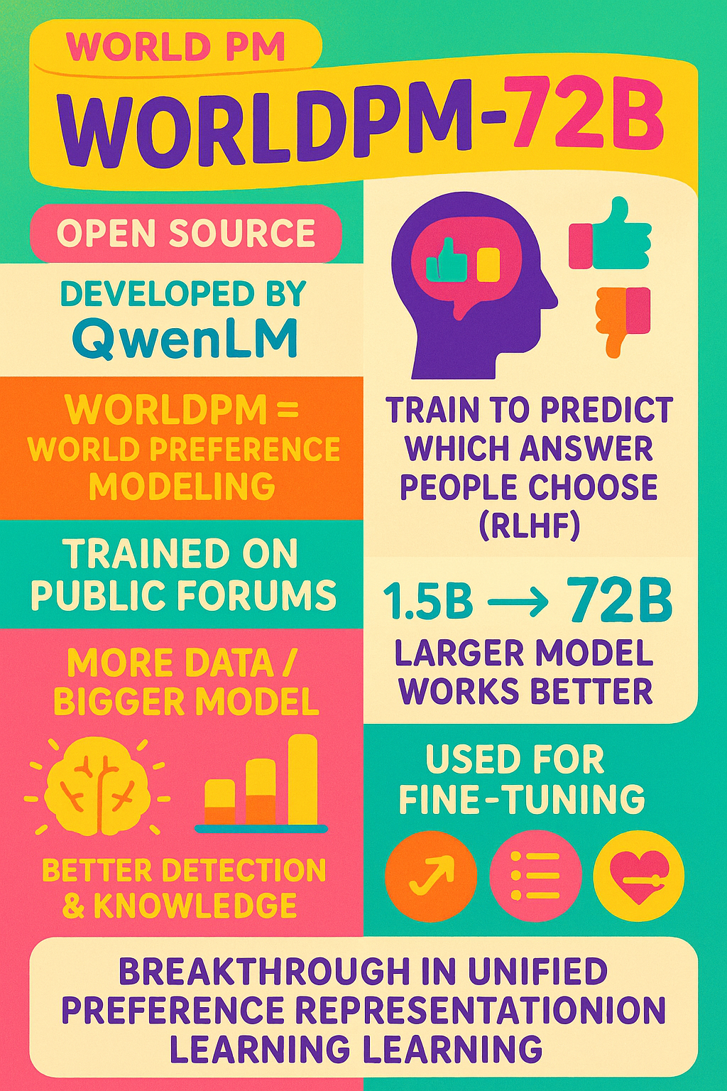
WorldPM
WorldPM-72B family of models - open source
Developed by QwenLM
WorldPM = World Preference Modeling
Idea - train the model to predict which answer people choose (RLHF)
a model can be trained on samples collected from diverse public forums
More data and bigger model (72B) - better ability of the model to detect deceptive/incomplete responses. Factual knowledge also grows with model size
The model can be used for fine-tuning as RLHF Optimization: Integrates into reinforcement learning pipelines, improving in-house evaluation scores by 4-8%; Response Ranking; Custom Preference Tuning
WorldPM represents a breakthrough in unified preference representation learning through large-scale training. While our experiments demonstrate strong generalization capabilities across various preference scenarios, we recommend task-specific fine-tuning for optimal performance.
https://arxiv.org/abs/2505.10527
https://github.com/QwenLM/WorldPM
https://huggingface.co/Qwen/WorldPM-72B
https://www.youtube.com/watch?v=JNNhXzwokZY - video
Note: this work used HelpSteer2 dataset. Since then HelpSteer3 was published - https://arxiv.org/abs/2505.11475

Slide 13
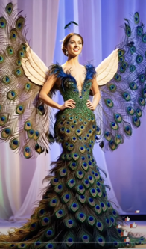

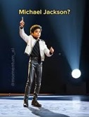


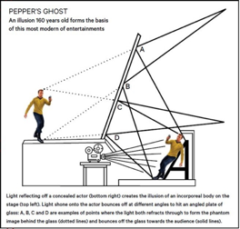
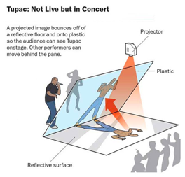
AGT AI Holograms
Real-Time Deepfakes and Fantasy Transformations
https://metaphysic.ai
search YouTube for AGT AI (AGT = America Got Talent)
search images for: holograms on stage setup
Current performances typically use tightly stretched, transparent films and high-resolution, laser-powered projectors that provide very crisp, true-to-life images while still allowing audiences to see the background stage details.
https://education.cosmosmagazine.com/cosmos-magazine-how-do-you-stage-a-holographic-concert-article/

Slide 14
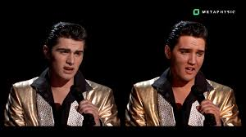

Metaphysic - metaphysic.ai
https://metaphysic.ai
Metaphysic specializes in hyper-realistic AI-generated content, enabling live deepfakes and face swaps on stage. Their technology allows a performer's face and voice to be transformed in real time
The process involves AI & ML models to map and synthesize faces and voices and to do it in real time during performances
The combination of deep learning models such as GANs (Generative Adversarial Networks) for face and voice synthesis and real-time video processing to map the generated faces onto live
performers
Projection systems or digital screens to display the transformed visuals to the audience in real time
Metaphysic's platform allows users to create their own deepfaked avatars using just a single image, demonstrating the accessibility and scalability of their technology
AGT has also featured AI-generated singers and dancers, some of which are entirely synthetic
How deep fake real time face transformation is achieved
First, hundreds or thousands of images of two faces are processed using an encoder AI.
Then, a decoder is used, separating the qualities of the faces
Once both of these steps are done, the algorithms are ready
A compressed image of person A’s face is fed into the decoder trained on person B. The decoder then reconstructs the face of person B with the expressions and orientation of face A.
Metaphysic is a small private company
2021 - founded in London, UK
Received $7.5 Mln as seed investment
2025 - acquired by Brahma at $1.75B valuation

Slide 15
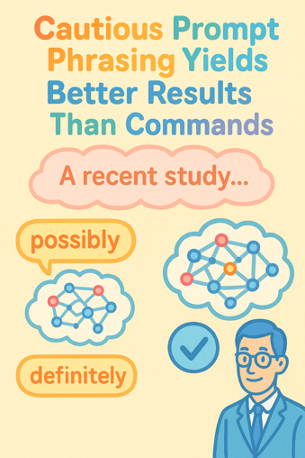
Cautious Prompt Phrasing Yields Better Results
Cautious Prompt Phrasing Yields Better Results Than Commands
https://arxiv.org/abs/2503.22746
A recent study once again confirms that cautious ("uncertain") phrasing in prompts works much more effectively than categorical commands.
When queries are formulated carefully and non-categorically (e.g., "possibly," "presumably"), neural networks perform a deeper analysis and provide more accurate answers. In contrast, categorical commands ("definitely," "exactly") more often provoke the neural network to follow false information.
Models with roles designated as "experts" prove to be more resistant to manipulation than simple (helpful agreeable) "assistants."

Slide 16
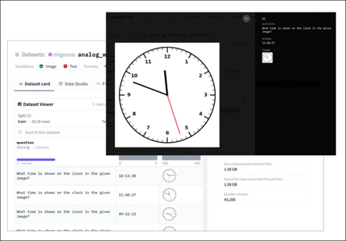

AI’s Struggle to Read Analogue Clocks
AI’s Struggle to Read Analogue Clocks
This is probably due to the lack of images with clocks at different times in their training set.
The paper demonstrates limitations of MLLMs to abstract and generalize
https://arxiv.org/abs/2505.10862 - paper
https://www.unite.ai/ais-struggle-to-read-analogue-clocks-may-have-deeper-significance/

Slide 17

One Hour Rule
One Hour Rule - think without interruption, concentrate on your main mission, the main problem that matters the most
https://www.youtube.com/watch?v=jSw7DIFQMH0
Practice of protecting "one sacred hour" each day to make meaningful progress on important work
The purpose of the one-hour rule isn't just productivity, but "rewiring your identity" - shifting from constantly reacting to thoughtfully designing solutions
Focus on the most impactful problem: "What's the one problem in your life that if solved would change everything else?"
Ask yourself a clarifying question: "What am I pretending not to know?" This helps cut through excuses and self-deception.
Protect this hour with a three-layer strategy:
Layer 1: Use consistent triggers (same time, place, tools)
Layer 2: Remove physical distractions and create a clean environment
Layer 3: Establish firm boundaries with others about this time
4. Be careful of "leakage" - those 5 minutes before your focused hour when you check messages or email, which can derail your entire session.
"reconnect with purpose"

Slide 18
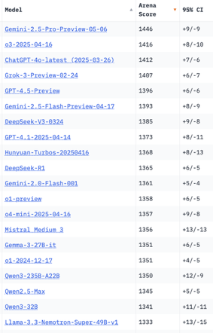
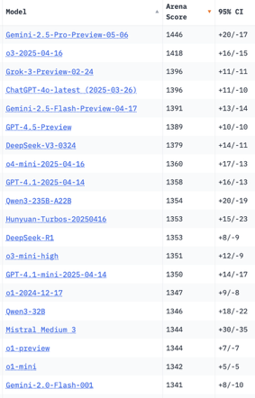
Crowd-sourced "LM Arena" Leaderboard
Starting Elo rating = 1000
95% CI = Confidence Interval
https://en.wikipedia.org/wiki/Elo_rating_system
Total #models: 239
Total #votes: 2,934,488
Last updated: 2025-05-18
https://chat.lmsys.org/?leaderboard
https://lmarena.ai/?leaderboard
https://openlm.ai/chatbot-arena/
https://beta.lmarena.ai
English-only queries
Coding
x.ai
x.ai
Web Leaderboard https://web.lmarena.ai/leaderboard
LLM Leaderboard - by @LlmStats https://llmworld.net/llm_leaderboards/
LLM Leaderboard - by StackAI https://www.stack-ai.com/llm-leaderboard
LLM Leaderboard - by Artificial Analysis https://artificialanalysis.ai/leaderboards/models
Open LLM Leaderboard - by Hugging Face https://huggingface.co/open-llm-leaderboard
LLM Leaderboard - by Vellum https://www.vellum.ai/llm-leaderboard
Multiple Leaderboards: https://virtualizationreview.com/articles/2025/04/29/ais-heavy-hitters-best-models-for-every-task.aspx
China
China
China
China
China
China
China
M
China
China
M
China
China

Slide 19
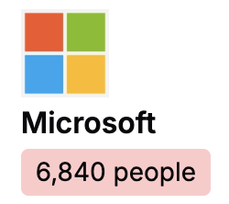
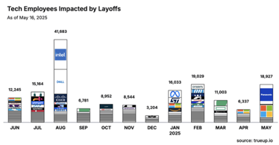

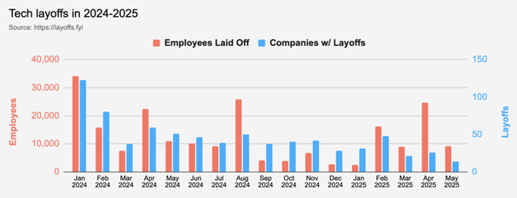
Jobs
On 5/13/2025, Microsoft laid off a total of 6,840 people (3% of company) globally
https://layoffs.fyi
Layoffs in 2025: as of 5/16/2025:
61,220 tech employees laid off
130 tech companies w/ layoffs
2024: more than 150,000 tech job cuts
across 549 companies

Slide 20


About the Speaker
Lev Selector, Ph.D.
40+ years of software engineering, data science, and building teams (hiring, training, and managing)
Ph.D. in mathematical modeling and computer simulations
Interests:
Generative AI, Using LLM with your data
Local AI for Local Private Data
Cloud architecture, fin-tech, application security
Find/connect: Linkedin, GitHub, YouTube, Google
https://eais.ai
Enterprise AI Systems

Slide 21
Thank You!

